Slide 1
Why public health should reconsider its alignment with the community food security movement
Lynn McIntyre MD, MHSc, FRCPC Professor and CIHR Chair in Gender and Health, University of Calgary lmcintyr@ucalgary.ca

Slide 2
Learning objectives
Consider the unintentional harm that may be occurring from public health alignment with community food security initiatives
Reflect upon how public health could advocate more critically for measures that would structurally reduce household food insecurity
Develop arguments and strategies that could shift public health's current community work related to food security to a more upstream approach

Slide 3
Food Insecurity
¹Inadequate or insecure access to adequate food due to financial constraints

Slide 4
Food insecurity is not the flip side of food security and the distinctions are terribly important

Slide 5
Notes:
Food insecurity is a persistent problem affecting almost one in 12 Canadian households. 8.1% [1 in 8 Canadian households with some type of food insecurity stress.]

Slide 6
Notes:
Some households are extraordinarily vulnerable, notably those reliant on social assistance, of which over half are food insecure. The many federal and provincial programs that comprise our ‘social safety net’ are failing to enable many Canadians to meet their basic food needs. The social patterning of vulnerability suggests that food insecurity is a problem of social policy—the failure of federal and provincial/territorial governments to ensure economic access to adequate food.

Slide 7
Source CCHS 4.1

Slide 8
Prevalence of HFI and Unemployment
by major census metropolitan area, Canada CCHS 2011
 |  |  |  |  | Food insecure (3-levels)
 | Unemploym’nt Rate (04.13) |  | Total households (000s)^{1,2} |  | N (000s) |  | Percent %
St. John's | 6.6 |  | 83.4 |  | 7.1 |  | 8.5
Halifax | 6.5 |  | 157.3 |  | 29.7 |  | 18.9
Moncton | 6.7 |  | 63.4 |  | 14.1 |  | 22.3
Saint John | 9.2 |  | 52.9 |  | 6.7 |  | 12.6
Quebec | 4.5 |  | 318.0 |  | 27.4 |  | 8.6
Montréal | 8.0 |  | 1,546.1 |  | 217.9 |  | 14.1
Ottawa-Gatineau | 6.2 |  | 464.0 |  | 41.7 |  | 9.0
Toronto | 8.4 |  | 2,073.4 |  | 259.4 |  | 12.5
Hamilton | 6.8 |  | 283.9 |  | 21.5 |  | 7.6
Winnipeg | 5.8 |  | 295.9 |  | 35.6 |  | 12.0
Regina | 4.8 |  | 86.0 |  | 11.5 |  | 13.3
Saskatoon | 3.7 |  | 109.1 |  | 11.4 |  | 10.5
Calgary | 4.7 |  | 479.1 |  | 57.8 |  | 12.1
Edmonton | 4.4 |  | 446.5 |  | 65.5 |  | 14.7
Vancouver | 6.8 |  | 933.0 |  | 87.6 |  | 9.4
Victoria | 5.3 |  | 137.0 |  | 21.3 |  | 15.5
¹ 'Total households' excludes those households with missing values for food security. That is, they did not provide a response to one or more questions on the household food security module.
² For CMAs other than Montreal, Toronto and Vancouver household numbers have been rounded to the nearest 50.
Average of all CMAs |  |  |  | 915.9 |  | 12.2
Notes:
Green good; red bad; blue average

Slide 9
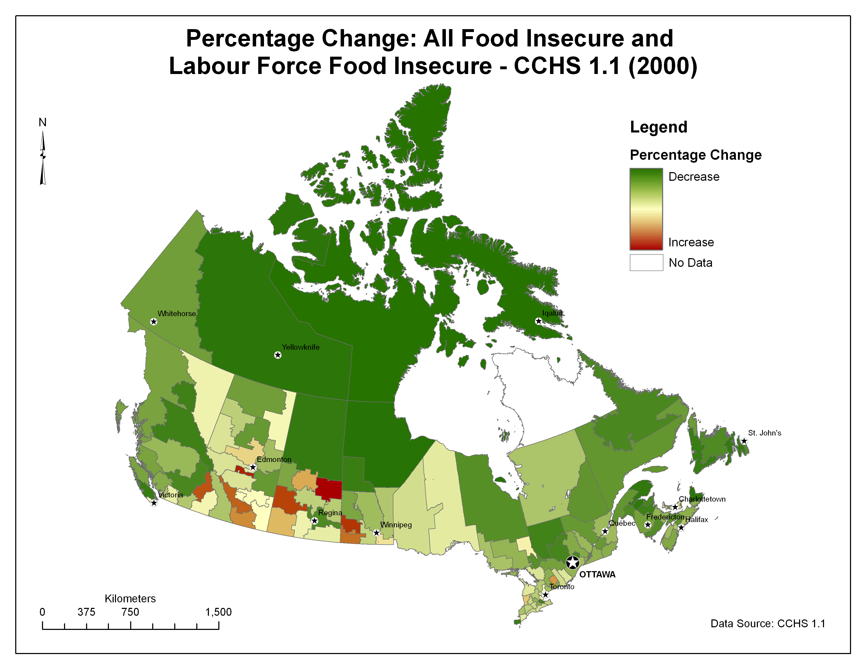

Slide 11
Main FI drivers Best FI Policy Practices
Structural determinants, leave certain groups vulnerable
FI vulnerability: low income as well as income shocks, and can be mediated by social transfers
Workforce participation & education, partial protection, but labour market practices can perpetuate FI
Income
Income volatility protection
Social protection/transfers
Labour protection
Fair market conditions
Higher education access

Slide 12
Dominant responses in the name of food (in)security
Food banks
Community gardens
Farmers’ markets
School food programs
Community kitchens
Community-supported agriculture
Food-related community economic development
If not run by Public Health; Public Health is a ‘partner’

Slide 13
Food bank use is the problem & The dominant solution is to Build Better food banks
Notes:
- emphasize the notion that food banks are not criticized - the focus is on the good work they are doing, how they are trying to be "better" (e.g., The Stop), and how this renders the recipients and the conditions that led them to be hungry invisible
-they are considered a self-appointed part of the social safety net

Slide 14
Why public health should rethink its involvement with ‘community food security’
Evidence base on reduction of FI is weak
Conflation if not deliberate appropriation of FI for other aims
Superficial community-based interventions undermine structural action
Most food sovereignty initiatives increase inequities
Health harm of FI is not food-based
The public health physician’s role should be to provide critical leadership to well-meaning staff who work with community food security actors.
Use their voice to pursue higher level public policy goals such as the reduction of poverty and income inequality.
Notes:
- Emphasize the notion of undermining e.g., backyard chickens undermining public health
-Emphasize the notion that health harm is not food-based -- food insecurity is not about food/won't be solved with food

Slide 15
http://nutritionalsciences.lamp.utoronto.ca

Slide 16
Thank you

